Slide 1
Students, if you are here, Begin where you are to go where you want to go (one step at a time with modifica-tions as needed)

Slide 2

Purpose of the Meeting Script
Hi, I am ________________________.
Welcome to my IEP meeting.
My disability is _____________________________, and it affects my education in the following ways:
_________________________________________________________
_________________________________________________________
_________________________________________________________
The purpose for this IEP meeting is to: _____________________________________________________________________________________________________________________________________________________________________
Example Purposes of IEP Meetings: Review goals, Monitor progress toward goals, Set new goals, etc.

Slide 3
Introductions Script
This is __________________, my ____________________. I invited him/her because ________________________________________.
This is __________________, my ____________________. I invited him/her because ________________________________________.
This is __________________, my ____________________. I invited him/her because ________________________________________.
This is __________________, my ____________________. I invited him/her because ________________________________________.
This is __________________, my ____________________. I invited him/her because ________________________________________.

Slide 4
Review Past Goals and Performance
STEP
Students:
Review your IEP goals and actions from the past year.
Did you meet your goals? If not, what action is needed to meet the goal?
Share any completed assessments like The Arc’s Self-Determination Scale FREE from http://tinyurl.com/ArcSDeval
Practice saying goals and actions.

Slide 5
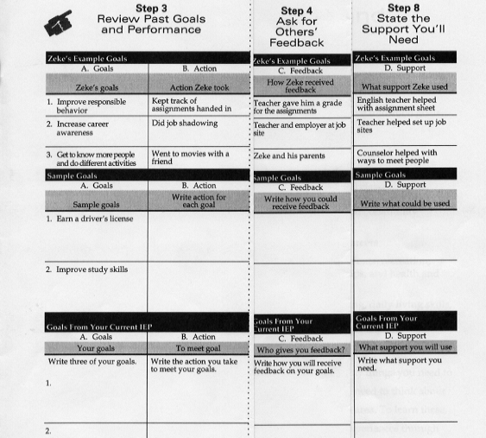

Slide 6
Review Past Goals/Performance Script
My education/transition (higher learning/training, employment, independent living) goal was ____________________________________________________________________________________
The action I took to meet my goal was ____________________________________________________________________________________
If you met your goals, congratulations! If you did not achieve a goal, is it important enough to include in your next IEP?

Slide 7
Ask for Others’ Feedback
STEP
Students:
How do you receive feedback?
Teacher grades
Parent input
Other ways: ____________________________
Practice saying goals, actions, and receiving feedback.

Slide 9
Receiving Feedback Script
My education/transition (higher learning/training, employment, independent living) goal was ____ ________________________________________The action I took to meet my goal was ________ ________________________________________
I received feedback by ____________________
_______________________________________

Slide 10
State School and Transition Goals
STEP
Students:
Discuss Tennessee’s three transition areas.
Higher education/training
Employment
Independent living
How do your interests, skills, and limits help you to choose goals?
Write your education & transition interests, skills, and limits, and how they impact goals.
Remember to include goals for Self-Advocacy (speaking for yourself) and Self-Determination (making your own choices).

Slide 11
School and Transition Goals
My education interests | My skills | My limits & how they impact goals

Slide 12
School and Transition Goals Script
My education/transition (higher learning/training, employment, independent living) goal is ______ ________________________________________
I am interested in _________________________ ________________________________________
The action I take to meet my goal is __________
________________________________________

Slide 13
Self-Advocacy & Self-Determination can be taught
Inventory your learning strengths, weaknesses to be improved, goals and interests, and choices for classroom learning
Provide your inventory information during the meeting
Ask questions
Respond to questions
Summarize your IEP goals
http://www.lessonplanet.com/ for Effective Communication, Self-Advocacy & Self-Determination lesson plans

Slide 14
Self-Advocacy & Self-Determination can be taught
Inventory completed by students listing their strengths, weaknesses, learning needs, goals, and choices which will prepare them for their upcoming IEP conference
Provide your inventory involves identifying appropriate time for individual to share information during the meeting, speaking clearly and completely, and referring to inventory as needed
Listen & Respond addresses being an active listener and responding to statements made by others in a positive manner
Ask questions focuses on asking appropriate questions to gather needed information
Name your goals to communicate goals and ideas on actions to be taken
http://www.postitt.org/activities/unit01/TM_self-advocacy.pdf Self-Advocacy
http://www.yai-rc.org/search/results_category-p/C14/ Self-Management

Slide 15
Self-Advocacy & Self-Determination can be taught
Students can learn five behaviors (SHARE) that enable effective communication:
Sit up straight
Have a pleasant tone of voice
Activate your thinking
Relax and
Eye communication
http://sdsp.uncc.edu/pdf/curriculum_components.pdf for list of Self-Advocacy & Self-Determination curricula

Slide 16
Ask Questions if You Don’t Understand
STEP
???
Students:
Ask questions about things you don’t understand.
Practice ways to ask questions in an IEP meeting when they don’t understand something.

Slide 17
Asking Questions to Understand Script
Excuse me, I don’t understand. Could you please explain that to me?
I’m sorry I didn’t get that. Could someone please help me out?
________________________________________________________________________________________________________________________

Slide 18
Deal With Differences in Opinion
STEP
Students:
Use the LUCK strategy to deal with a difference in opinion.
Learn and practice the LUCK strategy to deal with opinion differences.

Slide 19

The LUCK Strategy
Listen to and restate the other person’s opinion.
Use a respectful tone of voice.
Compromise or change your opinion if necessary.
Know and state the reasons for your opinion.
Practice makes perfect

Slide 20
State the Support You’ll Need
STEP
Students:
Discuss the support you will use to reach his new goals.
Ask other people how they can support you. You decide what support you need.
Practice stating goals, actions, feedback, and support.

Slide 22
Support You’ll Need Script
My education/transition (higher learning/training, employment, independent living) goal is __________________________ _________________________________________________
The action I take to meet my goal is ___________________
_________________________________________________
The support I will need is ____________________________
_________________________________________________
because my disability impacts me this way _____________ _________________________________________________

Slide 23
Summarize Your Goals
STEP
Students:
Discuss the four parts to a summary
Goal: ________________________________________
Action: ______________________________________
Feedback: ___________________________________
Support: _____________________________________
Summarize your current goals, the actions you need to take, how you receive feedback, and the support you need to accomplish goals.

Slide 24
Summarize Goals Script
My education/transition (higher learning/training, employment, independent living) goal is ________________________________ _______________________________________________________
The action I take to meet my goal is ________________________
_______________________________________________________
The support I will need is _________________________________
because my disability impacts me this way: __________________
_______________________________________________________
I receive feedback by _____________________________________

Slide 25
Close Meeting by Thanking Everyone
STEP
Students:
What would you want someone to say to you if you attended their IEP meeting?
Write a closing for your IEP meeting thanking everyone for participating.

Slide 26

Script
Thank You
Thanks for coming and thanks for all the help you’ve given me this year. I’m really glad you’ll be able to help me with my goals next year.
Thank you all for everything especially helping me meet my goals.
_____________________________________________________________________________________________________________________

Slide 27
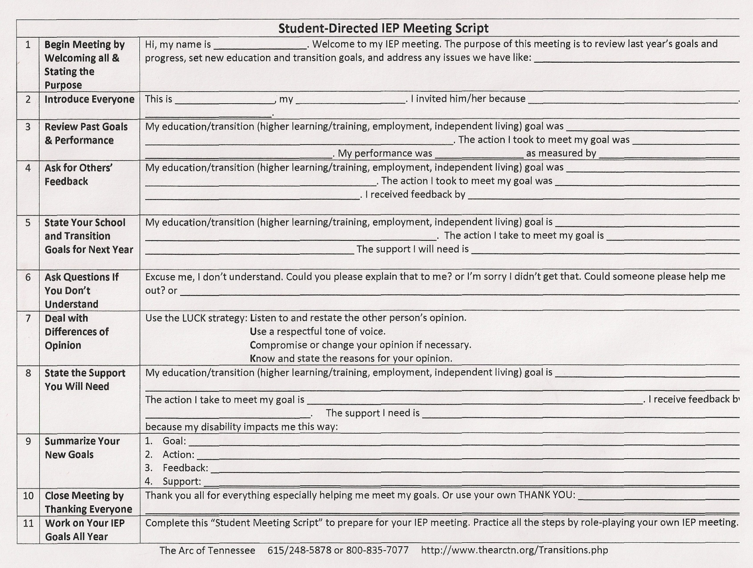
Student IEP Meeting Script
Download (and modify) from http://www.thearctn.org/Transitions.php

Slide 28
Student IEP Meeting Script
Download (and modify) from http://www.thearctn.org/Transitions.php

